Slide 1
Architecture - Mimir and Tyle
GitHub
https://github.com/mimir-org
Code packages
https://www.nuget.org/packages?q=mimirorg
https://www.npmjs.com/search?q=mimirorg
Docker images
https://hub.docker.com/u/mimirorg
Notes:
I will give you a brief overview of the architecture and thoughts for Tyle and Mimir.
Mimir and Tyle is already opensource applications. We have already settled down a minimum temporary community, that will take this project further.
We have called it Mimirorg for the lack of a better name. We try to share all our work through different channels.
You will find all of code and documentation from this Git organization.
This is also the place to report bugs and wanted features. And of course, we are in an early stage of the project.
Trust me, there will be some bugs and missing features.
We have set up a system for distributing shared code with automatic build and deployment and all finally build docker images.

Slide 2
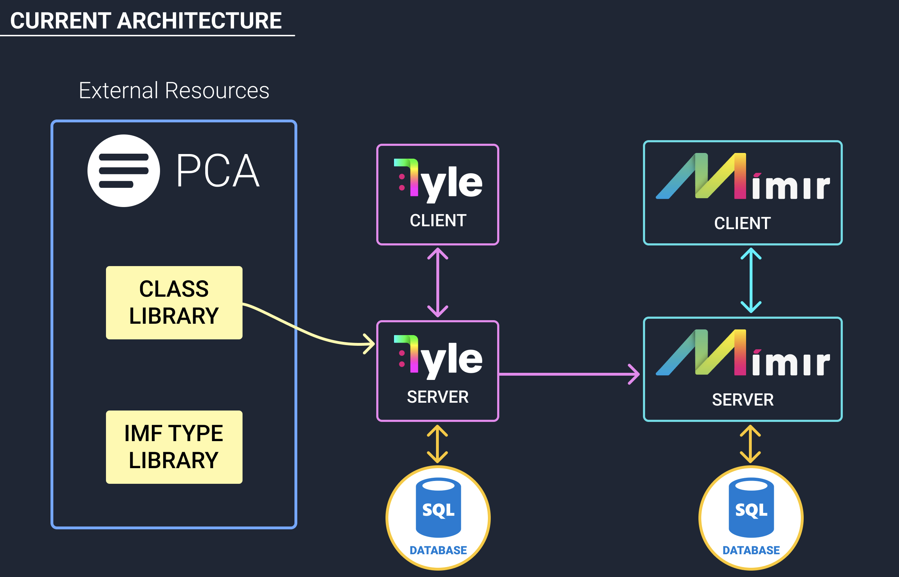
Notes:
It is important to understand that Tyle is not another ontology solution, but rather an application that can consume ontologies and create drawing tools for other applications and specially Mimir.
Today we are consuming data from PCA. We have implemented a SPARQL web-client, that fetch data from PCA. In this first stage we are linking attribute definitions, unit of measurement, Quantities, Range or Quantity datums and Range datums.
In the future we wish to consume as much data as possible. We want to minimize the number of sources. Of experience it does not scale very well. I think Magnus and others in the team will talk more about the roadmap afterwards.
Tyle and Mimir has a React client and a .Net backend application. You can find more information about the technology stack at the GitHub repository. Each application has a SQL backup store.
Some of you have already seen Mimir. Mimir is the application that using the types to do facility work. You will have a short demo on this after I am finished talking.
Tyle will run as a separate instance and serve all Mimir applications. That because we want to reuse types across the industry. It will generate less work for everybody, and maybe the most important thing is to reduce the risk of failure.
Increased synchronization of data between applications increases the probability of errors.
Common questions we get is, why do we need Tyle in between? It is hard to create a good user-friendly application with only types from different ontologies. We want to create as much reusable data as we can, to reduce the workload for all the Mimir users.
Another important reason, is that there is no system that contains all the data we need.
Think about Tyle as a template editor, and not a type-editor. Some of these templates could also possibly become types or IMF types.

Slide 3
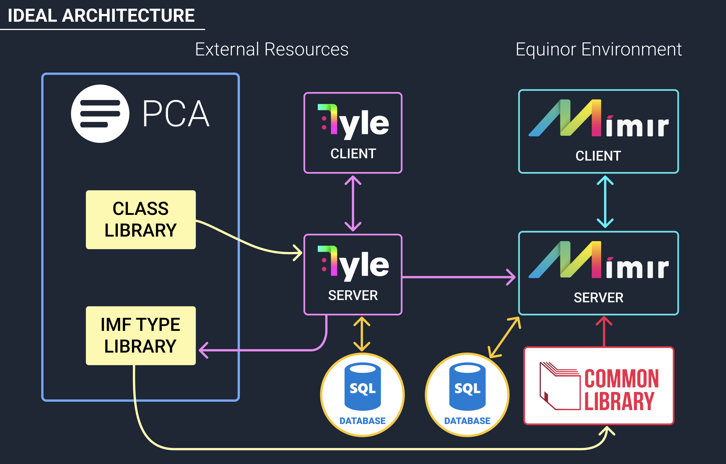
Notes:
In the future, we wish to send combined data back to the PCA library as IMF types as shown in the drawing.
Also in the future, we wish to include Equinor’s Common Library as an internal source for data. Our code is structured in a way that makes it possible to include other sources.
At the present time we are not sure what area of responsibility Common Library will have, but I think it will have a central position in sharing IMF data.
It is important for us at this step, to not make an architecture that exclude other sources in the future.
Olav will now give us a demo of Tyle.

